Slide 1
Neural Networks for Classification
Instructor: Mohammad Hasan
Office: 13-240
10/12/26
Notes:
Welcome and Introductions

Slide 2
Overview
Using Neural Networks for Classification
Classification Metrics
Classification Challenges

Slide 3
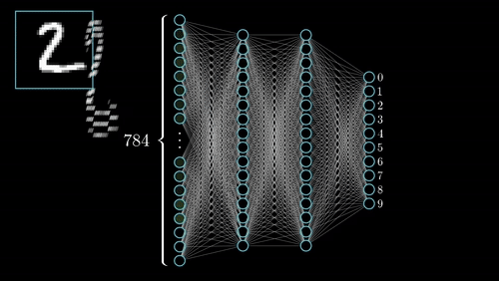
Neural Networks for Classification
We have seen the general workings of a neural network:
Prediction: data flows forward
Learning: error flows backward (more computationally expensive)
Studied examples: regression.
What about classification? (example aside)

Slide 4
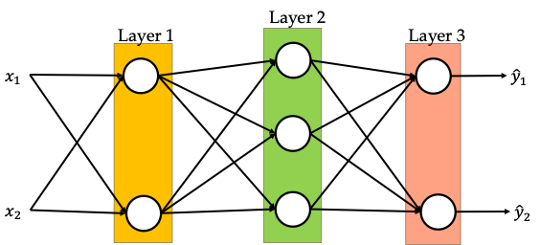
Neural Networks for Classification

Slide 5
Neural Networks for Classification

Slide 6
Confusion Matrix
We often like to report our data in a table called a “confusion matrix”
Consider a binary classification problem with 2 classes: Positive and Negative:
Actual class | Positive (prediction) | Negative (prediction)
Positive (actual) | True positive (TP) | False negative (FN)
Negative (actual) | False positive (FP) | True negative (TN)

Slide 7
Classification metrics
Actual class | Positive (p) | Negative (p)
Positive (a) | True positive (TP) | False negative (FN)
Negative (a) | False positive (FP) | True negative (TN)

Slide 8
Precision-Recall Trade-off
Often, there is a trade-off between precision and recall. Why?
How can we make use of both precision and recall while acknowledging the trade off?

Slide 9
Accuracy vs F1-Score
Both are commonly used as metrics for classification.
They measure different things.
Accuracy focuses on correctness in predictions.
F1-Score focuses on missing positives (FN) or making incorrect positive guesses (FP).

Slide 10
Precision, Recall and F1 score in multiclassification problems
Precision, Recall and F1 scores can be reported for one class or for the entire ML algorithm
 | Class A (prediction) | Class B (prediction) | Class C (prediction)
Class A (actual) | 3 | 1 | 0
Class B (actual) | 1 | 2 | 0
Class C (actual) | 0 | 1 | 2

Slide 11
Precision, Recall and F1 score in multiclassification problems
 | Precision | Recall
Class A
Class B
Class C

Slide 12
General Challenges for classification
Overfitting
Data leakage
Distribution shift
Label quality
Data imbalance
Notes:
Overfitting: training performance exceeds results on new cases.
Data leakage: test information enters training or model selection.
Distribution shift: future inputs differ from the training data.
Label quality and calibration affect the meaning of predictions.

Slide 13
General Challenges for classification (solutions)

Slide 14
References
Materials from this handout used Machine Learning, A First Course for Engineers and Scientists by Lindholm et. al (March 4th, 2026 version), section 6.1 as a reference. Access to this document is free at the publishers’ GitHub page.
The following was also used for materials: Artificial Intelligence: A Modern Approach, Russel and Norvig, 4th edition, section 21.1.

Slide 15
Extra notes

